Slide 1
Life Expectancy Analysis
By
Sadia Azeem

Slide 2
1
Overview
2
Problem Breakdown
3
Key Areas
AGENDA
4
Insights
5
Recommendation
6
Dashboard

Slide 3
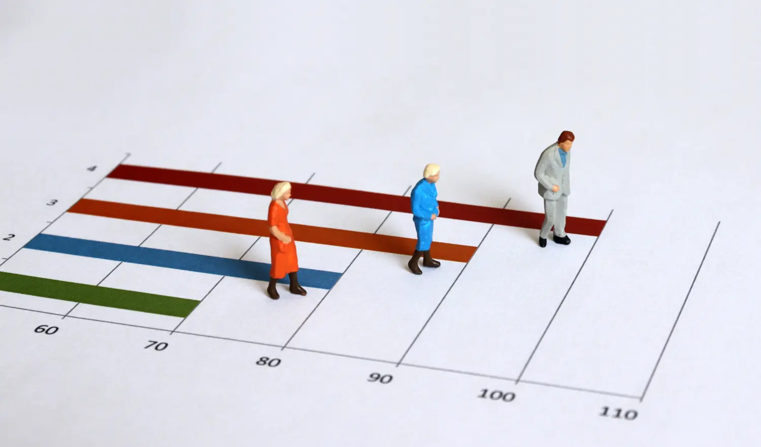
Overview
Life Expectancy is an average number of possible years of life remaining at birth.
Importance: It is used to calculate a country’s overall rank for the Human Development Index.
Health
Knowledge
Standard of Living

Slide 4
Problem breakdown: Workflow
CSV File
Import in MySQL
Data warehousing
Power BI
Measures/CC
Data Visualization

Slide 5
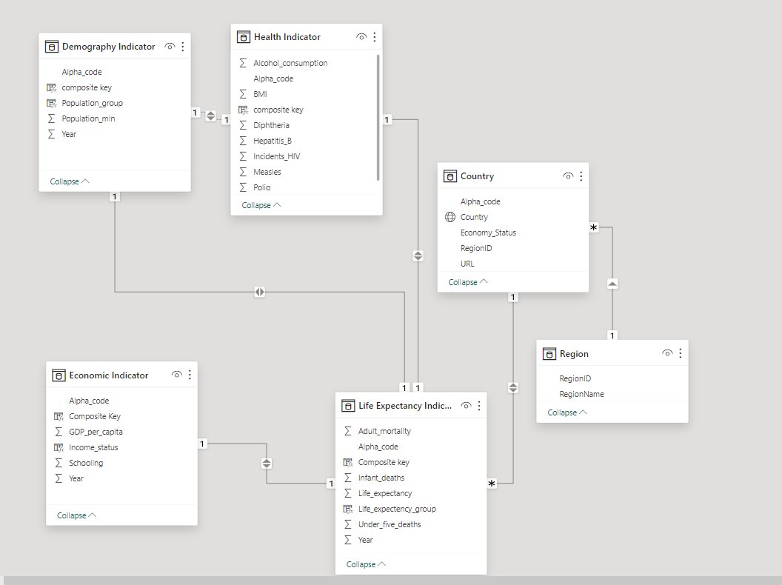
Problem breakdown: Data Modelling
Region
Country
Demographic Indicators
Health Indicators
Economic Indicator
Life Expectancy Indicator

Slide 6
Key Area
Overview life expectancy trend
Life Expectancy Trend
Change in Mortality and life Expectancy
Percentage Division of Mortality
Correlation Analysis of Health Indicators
Infectious Diseases and Life Expectancy
Immunization and Infant Deaths
Lifestyle and Life Expectancy
Impact of Socio-Economic Factors on Life Expectancy
Income level and Life Expectancy
Density and Life Expectancy

Slide 7
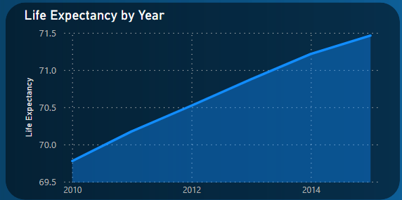
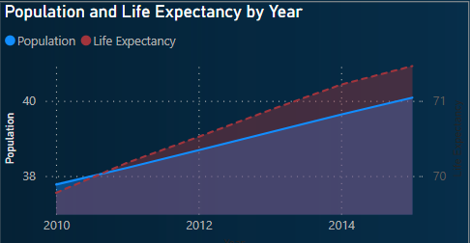
Insights - Life Expectancy Analysis

Slide 8
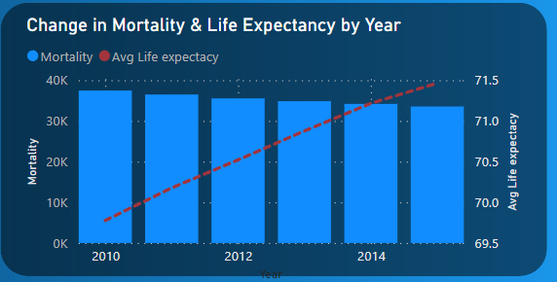
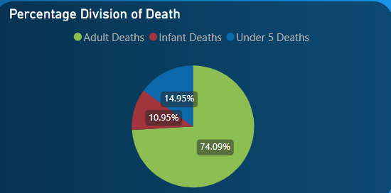
Life Expectancy Analysis

Slide 9
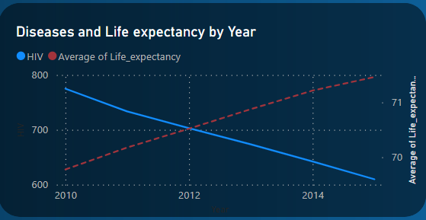
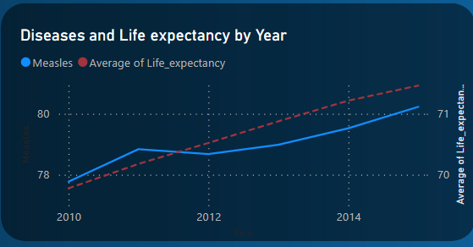
Factors 1:Infectious Diseases:
HIV
Measles

Slide 10
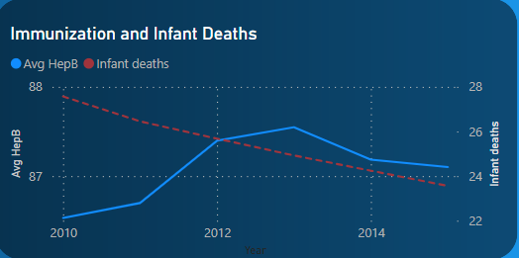
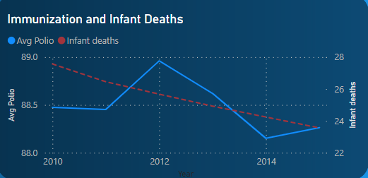
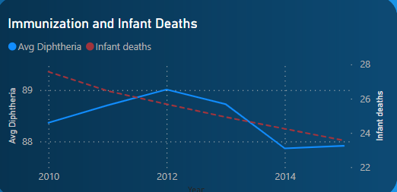
2: Immunization:
Hepatitis B
Polio
Diphtheria

Slide 11
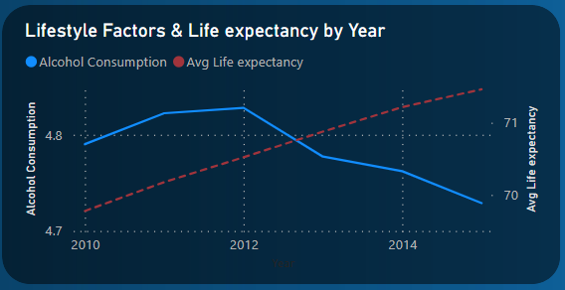
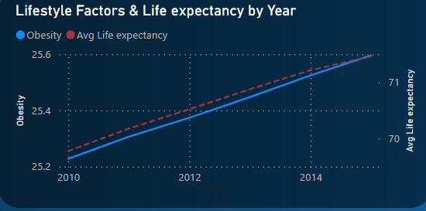
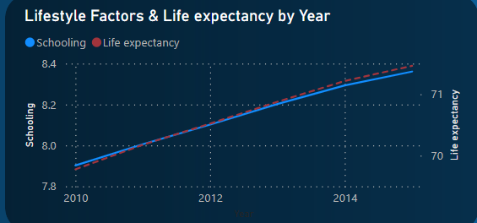
3: Lifestyle:
Alcohol
Obesity
Schooling Years

Slide 12
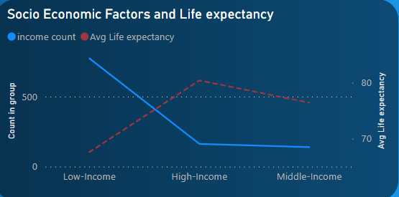
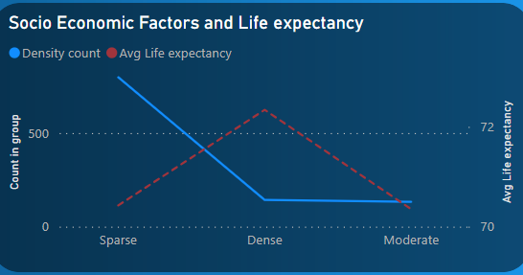
4: Socioeconomic Factors
Income Level
Population Density

Slide 13

Recommendation
Schooling
Lifestyle
Health Expenditure Study
Steps to curb Alcohol Consumption

Slide 14
Dashboard

Slide 15
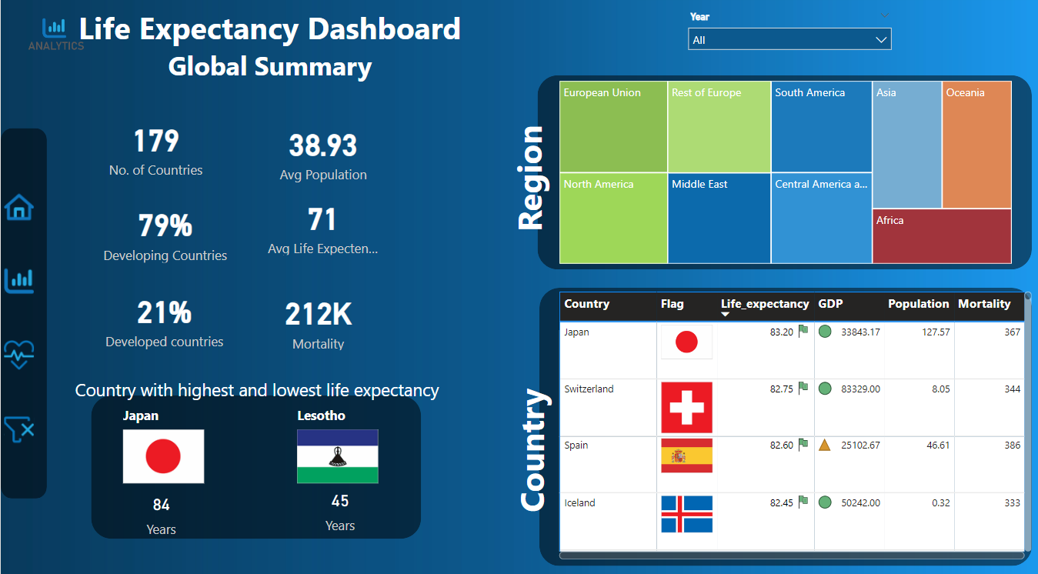

Slide 16
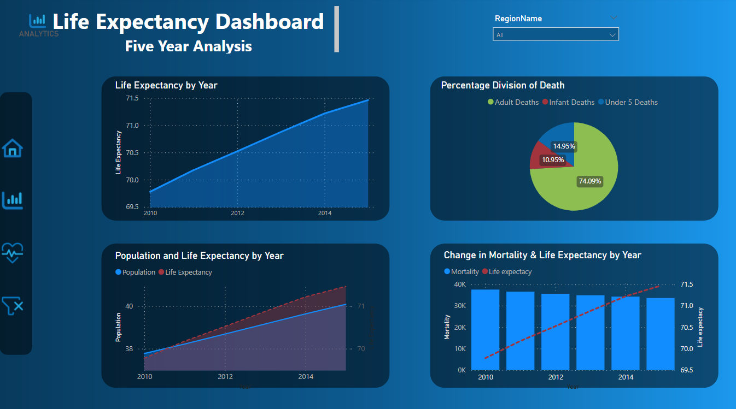

Slide 17
